Slide 1
Measurements of Energy Losses in Ferrite Samples
Benjamin Gladwyn
Wednesday Group Meeting
07/12/2023
bengladwyn/Fermilab: Measuring the properties of Ferrites for RF cavities (github.com)

Slide 2
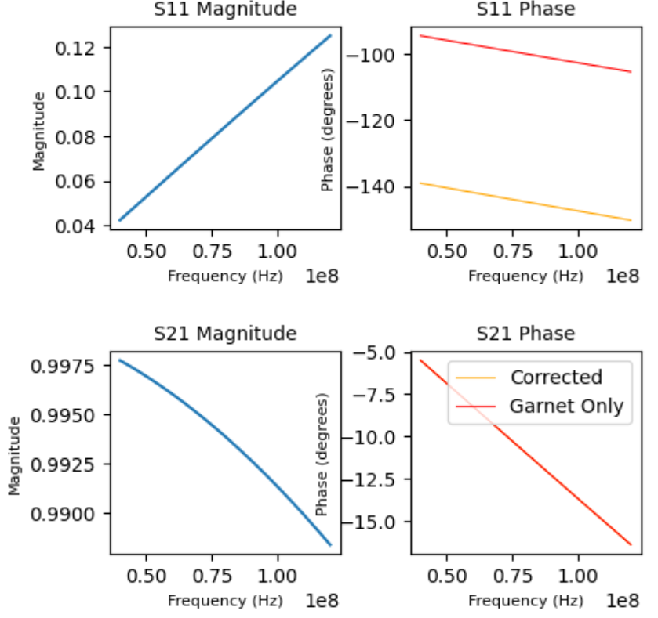


Relative Permittivity and Permeability Measurements
Measure s-parameters of empty holder and when sample is present
Manipulate phases to realize phases of the garnet sample only
Phase of ½ inch sample + fittings
Phase of empty holder and fittings
Calculated phase of ½ inch of air
$$−$$
$$+$$
=

Slide 3
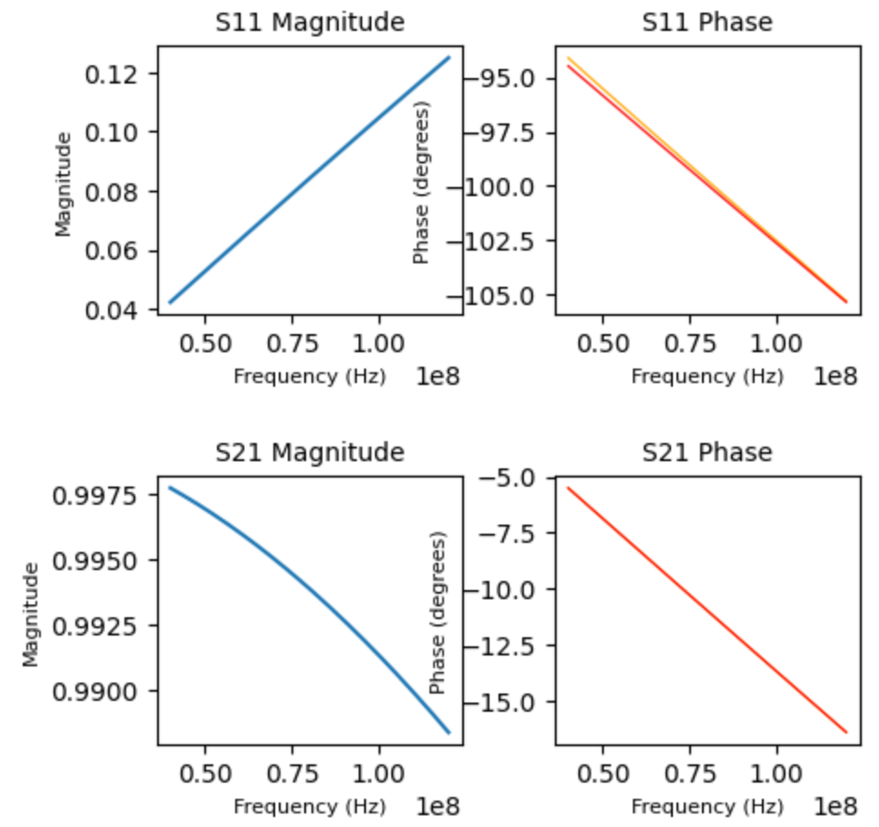
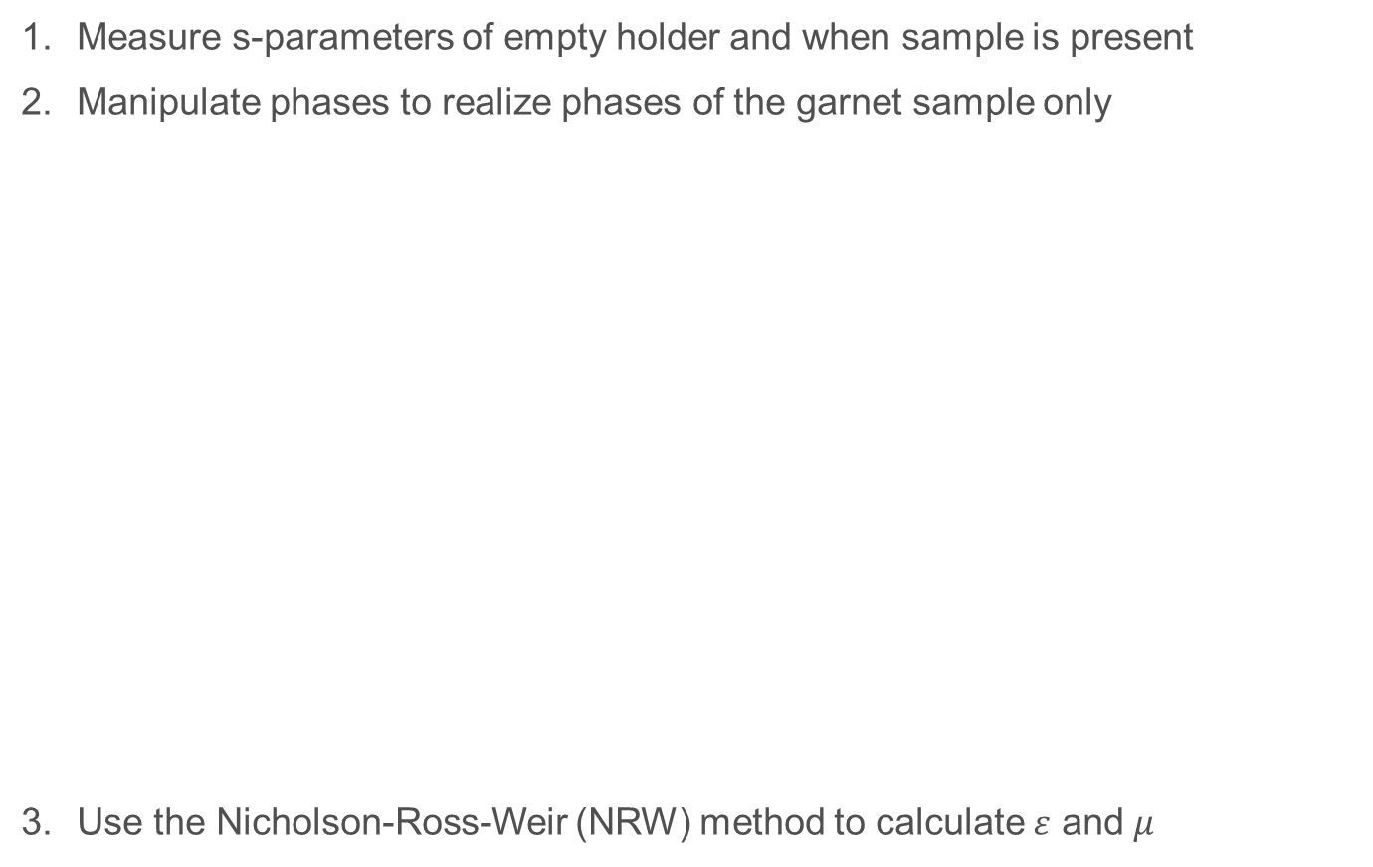

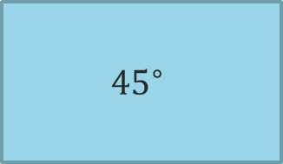
Relative Permittivity and Permeability Measurements
Measure s-parameters of empty holder and when sample is present
Manipulate phases to realize phases of the garnet sample only
Use the Nicholson-Ross-Weir (NRW) method to calculate $ε$ and $μ$
Phase of ½ inch sample + fittings
Phase of empty holder and fittings
Calculated phase of ½ inch of air
$$−$$
$$+$$
Simulation
$${45}^{∘}$$
?
$$±$$
=
Measurements

Slide 4
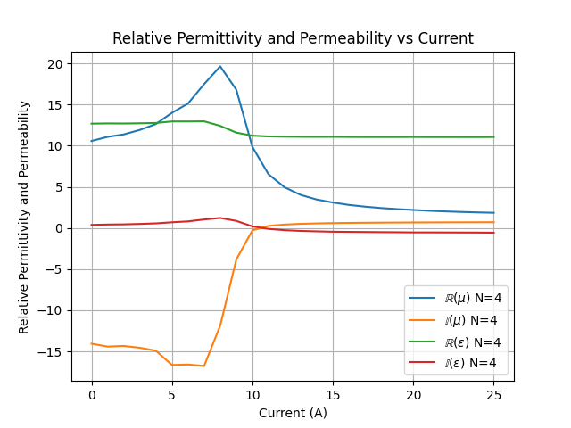
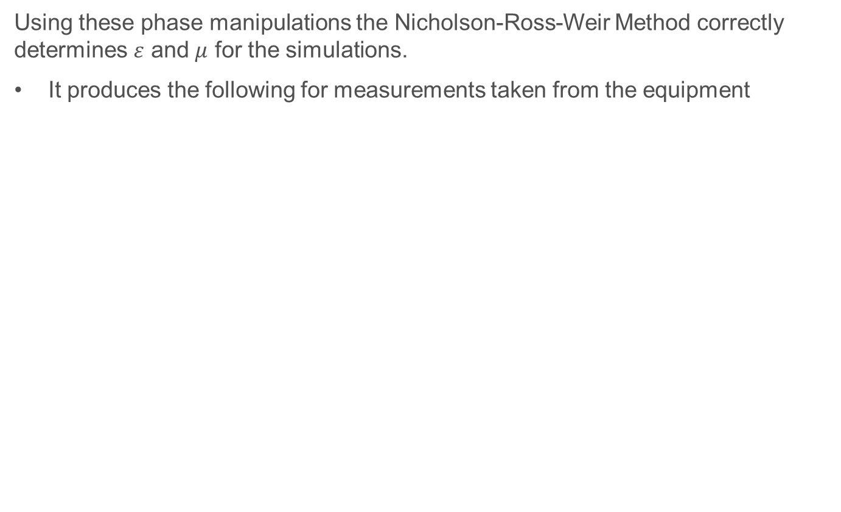
Relative Permittivity and Permeability Measurements
Using these phase manipulations the Nicholson-Ross-Weir Method correctly determines $ε$ and $μ$ for the simulations.
It produces the following for measurements taken from the equipment
Sample L74087BAN4
?
Negative

Slide 5
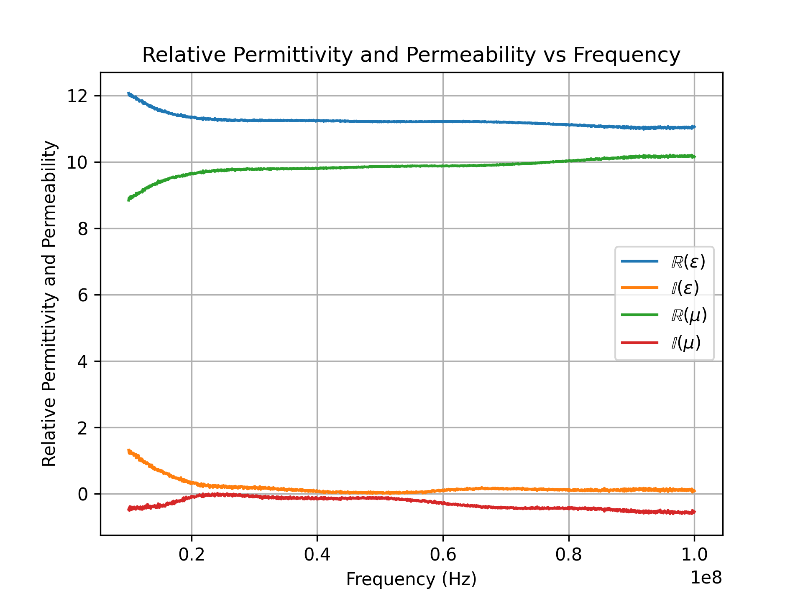
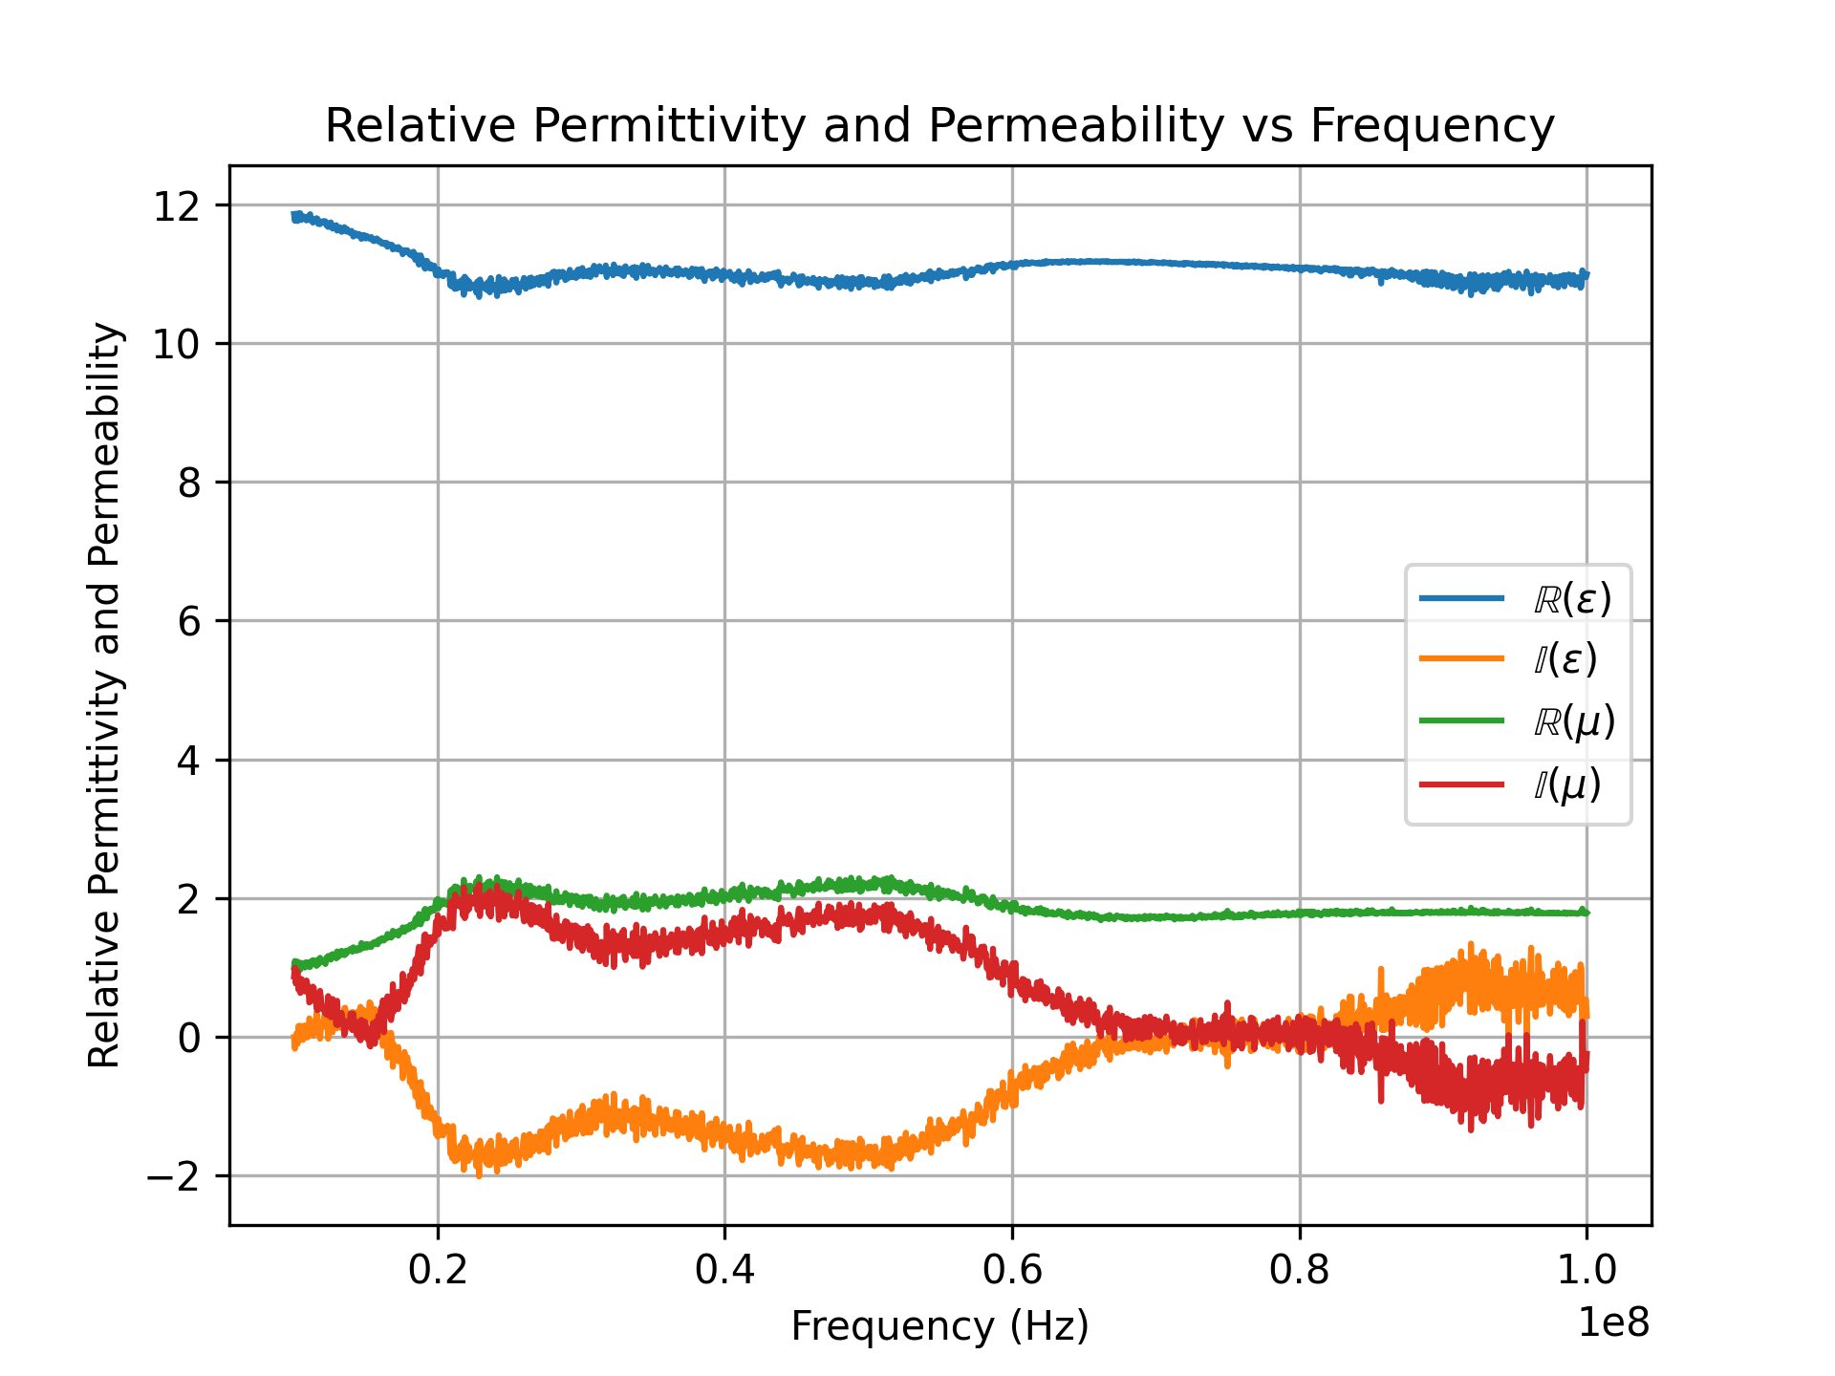
Relative Permittivity and Permeability Measurements
Across the frequency spectrum at different bias currents we have the following
0A
10A
25A
Sample L74087BAN4

Slide 6
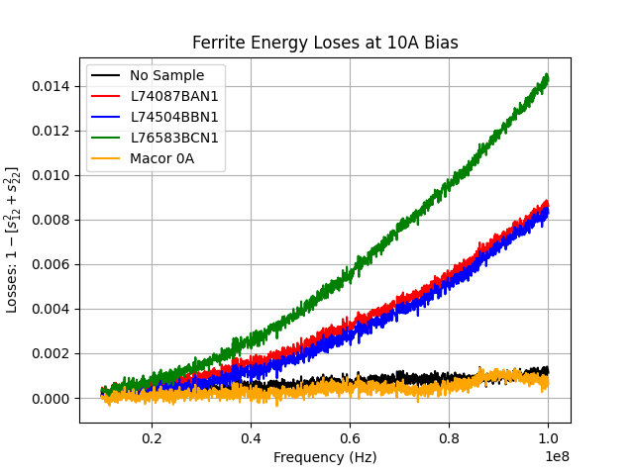
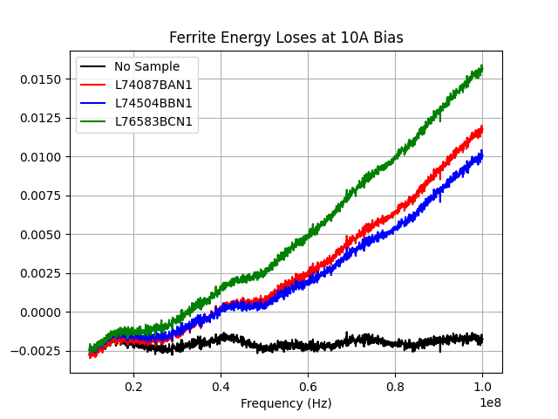
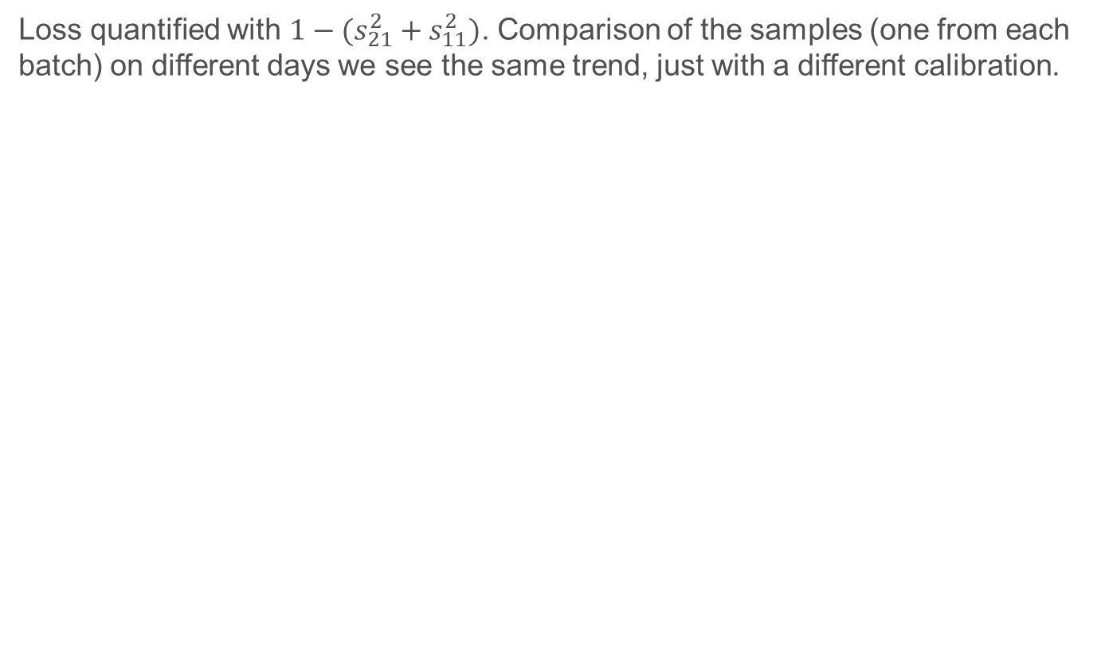
Loss Measurements
Loss quantified with $1−(s_{21}^{2}+s_{11}^{2})$. Comparison of the samples (one from each batch) on different days we see the same trend, just with a different calibration.
07/10/2023
07/11/2023

Slide 7
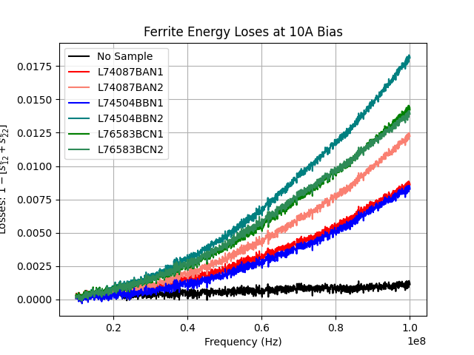
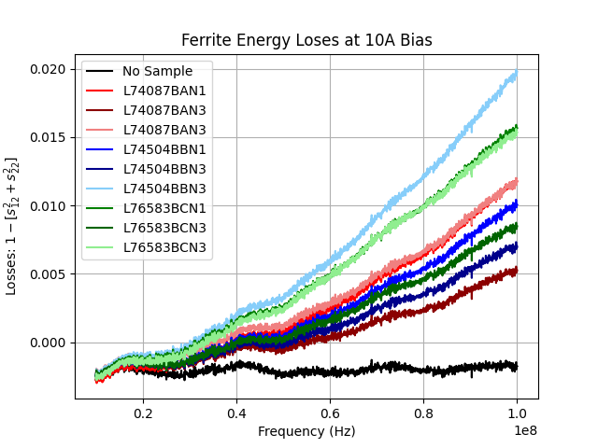
Loss Measurements
07/10/2023 – 2 different samples of each batch measured
07/11/2023 – 3 different samples of each batch measured
No discernible differences between the batches, only between samples.
07/10/2023
07/11/2023

